Slide 1
Journey to the Promised Land 1
How did God meet with Israel?

Slide 2
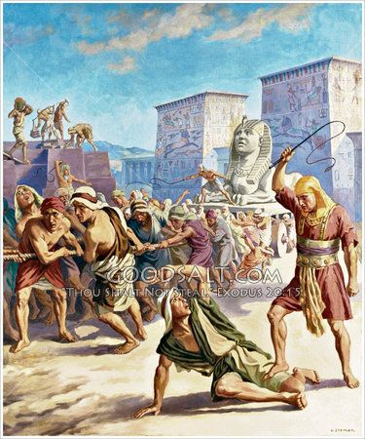
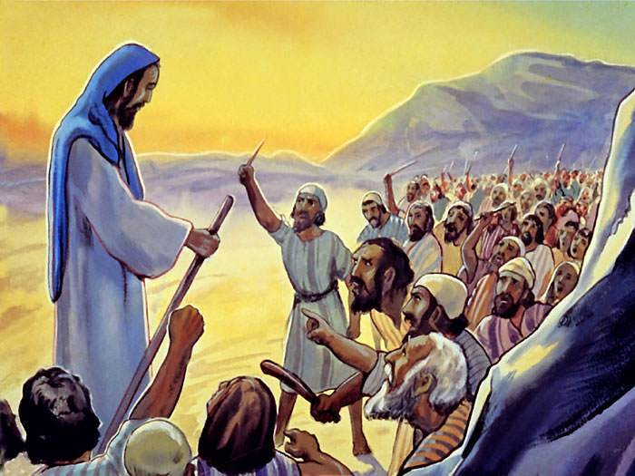
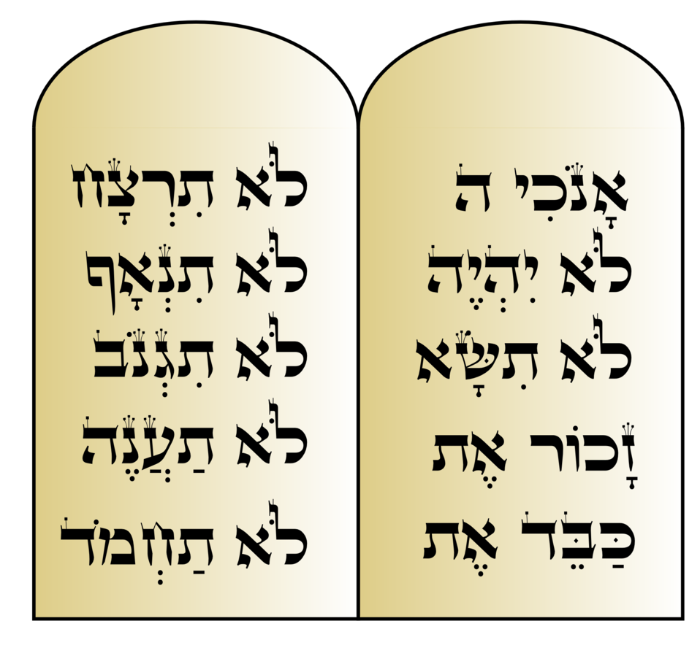
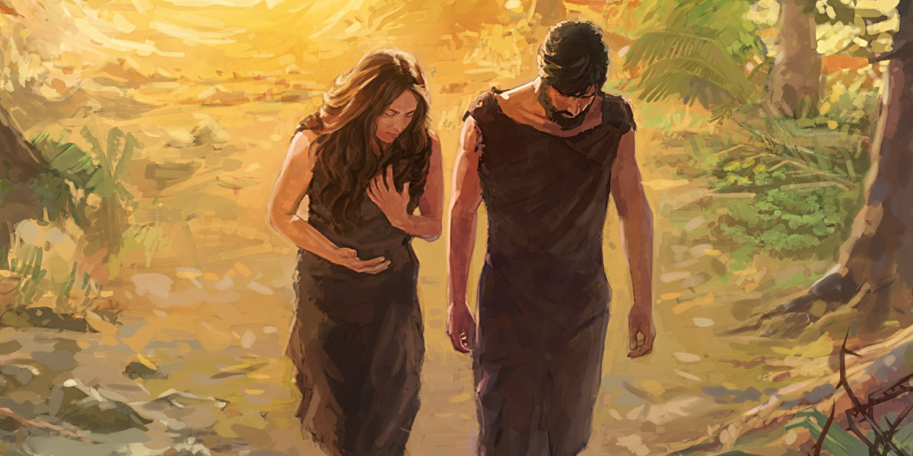
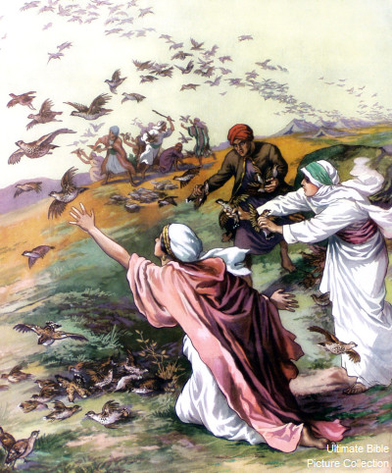
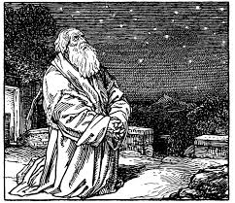
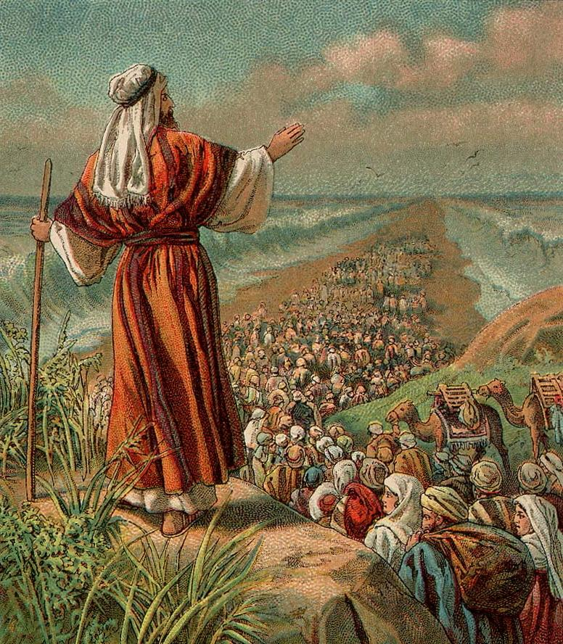
The STORY so far...can you name each event?

Slide 3
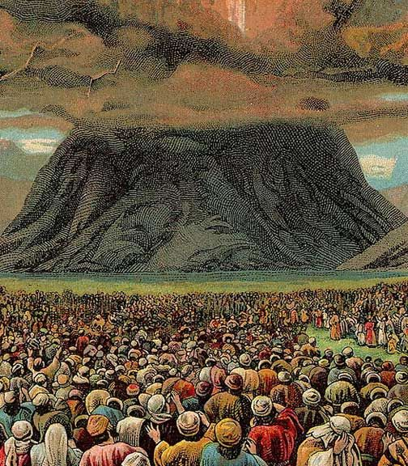
The STORY so far...
God rescued his people and asks them to live like they have been set free.
...but Israel keeps falling back into idolatry and complaining against God despite seeing all the miracles and his power to save them and crush the Egyptians

Slide 4
Main Lesson for Today
In the Old Testament, God lived with his people, but he was too holy for them to come near so a special tent was needed.
But for us, God can live in our hearts because of Jesus’ life and death and resurrection.

Slide 5
God’s Holiness
Where have you heard the word “Holy” before?
What do you think it means?
https://www.youtube.com/watch?v=l9vn5UvsHvM&ab_channel=BibleProject
What is Holiness?
Notes:
Staff room, principal’s room
You’re not meant to go there.

Slide 6



Yahweh is Holy
YHWH
Moses
Everyone else

Slide 7
God is Holy and all evil gets burnt up near him
But he wants to live with his people
How would you solve this problem?

Slide 8




HOLY GOD
SINFUL MAN

Slide 9

HOLY GOD
Special tent of meeting - Exodus 25
Purification zone
SINFUL MAN

Slide 10
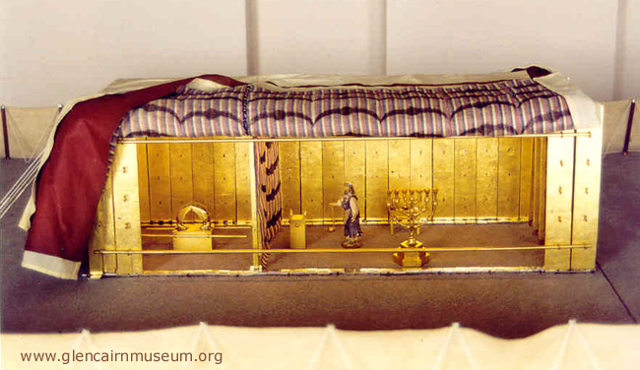
“Tabernacle” Holy Place
YHWH
The Holy of Holies was hidden by a thick curtain Not just anyone could enter God’s presence. High Priest can only enter once a year after being super ceremonially clean

Slide 11
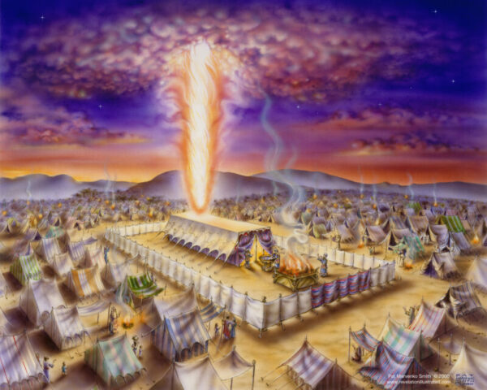
“Tabernacle” Holy Place
The Holy of Holies was hidden by a thick curtain Not just anyone could enter God’s presence. High Priest can only enter once a year after being super ceremonially clean
Unclean + non-Israelites waited outside
YHWH + High Priest
Clean Israelites
Priests

Slide 12
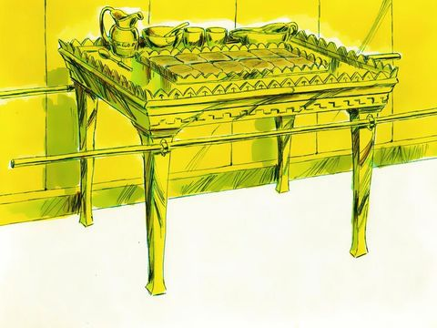
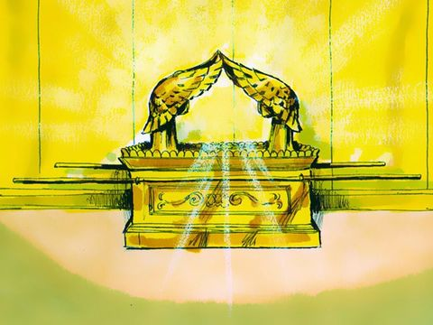
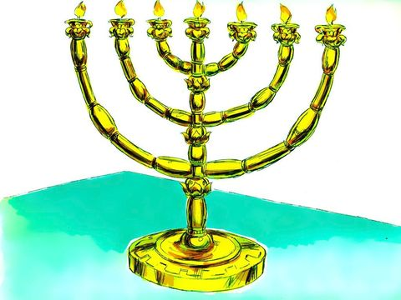
“Tabernacle” God’s Throne
It was fit for the King Ark of the Covenant - God’s Throne from which he lived with Israel in a special way.
After God’s presence filled the ark, anyone who touched the ark was struck dead on the spot.
Everything was covered in GOLD!
Notes:
Omniscience vs special throne.

Slide 13
Yahweh is Holy
YHWH
Sinful humans

Slide 14
Yahweh is Holy
YHWH
Why do we want to approach God?
Sinful humans

Slide 15
Yahweh is Holy
YHWH
Why do we want to approach God?
LOVE | BEAUTY | JOY | KINDNESS | JUSTICE | MEANING | FULL LIFE ...
Sinful humans

Slide 16
Yahweh is Holy
YHWH
If we could remove our sin...
LOVE | BEAUTY | JOY | KINDNESS | JUSTICE | MEANING | FULL LIFE ...
Purified humans
Sinful humans

Slide 17
Yahweh is Holy
YHWH
If we could remove our sin…
We could approach God!
LOVE | BEAUTY | JOY | KINDNESS | JUSTICE | MEANING | FULL LIFE ...
Purified humans
Sinful humans

Slide 18
Yahweh is Holy
YHWH
If we could remove our sin…
We could approach God!
LOVE | BEAUTY | JOY | KINDNESS | JUSTICE | MEANING | FULL LIFE ...
LOVE | BEAUTY | JOY | KINDNESS | JUSTICE | MEANING | FULL LIFE ...
Purified humans
Living Full Lives!
Sinful humans

Slide 19
The only way to Holy God is GOD’S WAY
Everything else:
LOVE if you perform
PEACE...for now
MEANING until you find someone better
JOY until you check IG

Slide 20
The only way to Holy God is GOD’S WAY
Everything else:
LOVE if you perform
PEACE...for now
MEANING until you find someone better
JOY until you check IG
Through Jesus:
LOVE you can’t lose
PEACE that death cannot steal
MEANING that will satisfy forever
JOY at always being with the one you love
BEAUTY that you’ll never get bored of
...
KINDNESS JUSTICE | MEANING | FULL LIFE | PEACE with GOD

Slide 21
Main Lesson for Today
In the Old Testament, God lived with his people, but he was too holy for them to come near so a special tent was needed.
But for us, God can live in our hearts because of Jesus’ life and death and resurrection.

Slide 22
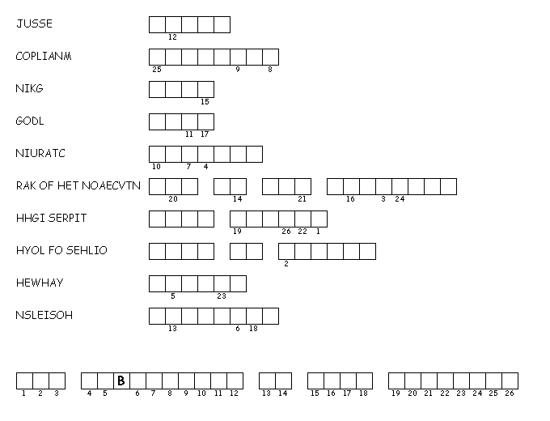
Breakout - How did God meet the Israelites?
Who purified sinful man to bring us to God?
When they were thirsty in the desert, what did the Israelites do to God?
The decorations of were so royal to be fit for a ____.
The items and interior of this were covered in ____.
A thick _______ separated the presence of God from the priests to protect them.
On what item did God’s presence appear to Israel?
Who was the one person allowed to be in God’s presence once a year?
What was the name of the inner chamber where the ark was kept?
What is the personal name of God that He revealed to us?
________ describes how God is so separate from humans in purity and status.
S
M
P
U
N
K
C
H
R
H
O
Y
H

Slide 23
The only way to Holy God is GOD’S WAY
Everything else:
LOVE if you perform
PEACE...for now
MEANING until you find someone better
JOY until you check IG
Through Jesus:
LOVE you can’t lose
PEACE that death cannot steal
MEANING that will satisfy forever
JOY at always being with the one you love
BEAUTY that you’ll never get bored of
...
KINDNESS JUSTICE | MEANING | FULL LIFE | PEACE with GOD

Slide 24
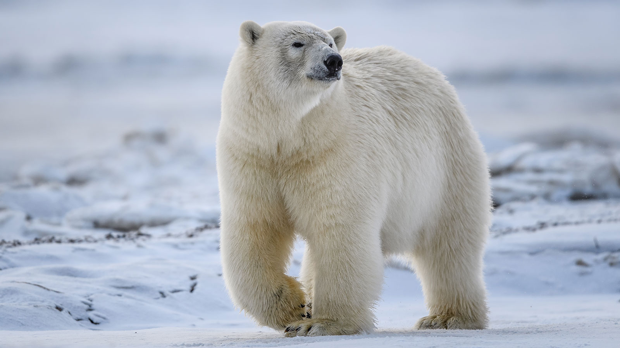

Slide 25
Recap for Week 2

Slide 26
The STORY so far...
God rescued his people from slavery and asks them to live like they have been set free.
...but Israel keeps falling back into idolatry and complaining against God despite seeing all the miracles and his power to save them and crush the Egyptians

Slide 27
Yahweh is Holy
YHWH
Sinful humans

Slide 28
Yahweh is Holy
YHWH
If we could remove our sin…
We could approach God!
LOVE | BEAUTY | JOY | KINDNESS | JUSTICE | MEANING | FULL LIFE ...
Purified humans
Sinful humans

Slide 29
God told Moses to build the “Tabernacle”
Unclean + non-Israelites waited outside
YHWH + High Priest
Clean Israelites
Priests

Slide 30
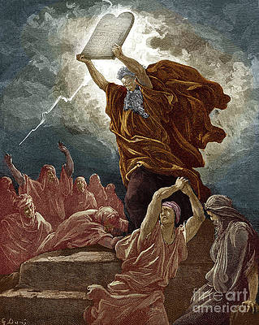
But before Moses could build the tabernacle, he caught the Israelites doing a terrible and evil thing...

Slide 31
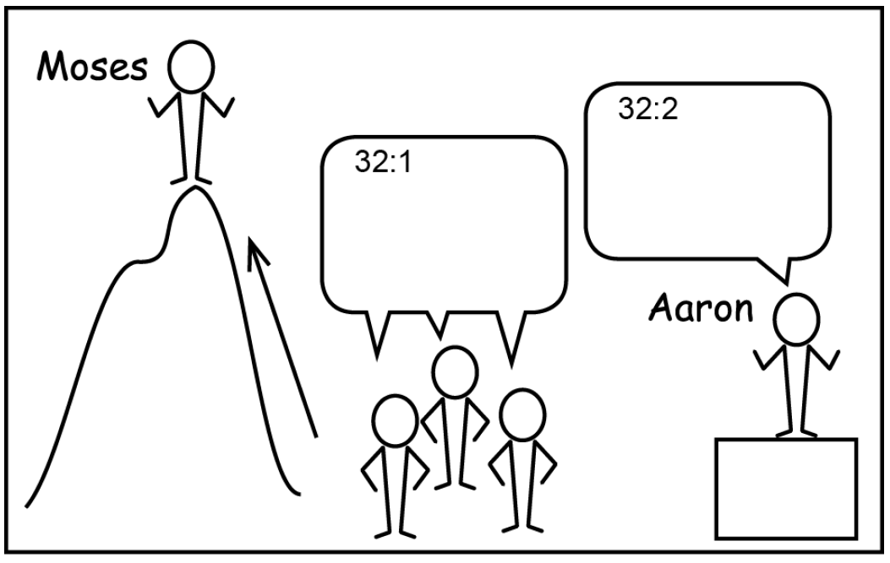
Collect all your jewellery and give them to me
Moses has disappeared, so who will lead us?

Slide 32
Tomorrow let’s worship the calf. I’ll throw the biggest party this desert has ever seen.
The golden calf is your god who rescued you from Egypt

Slide 33
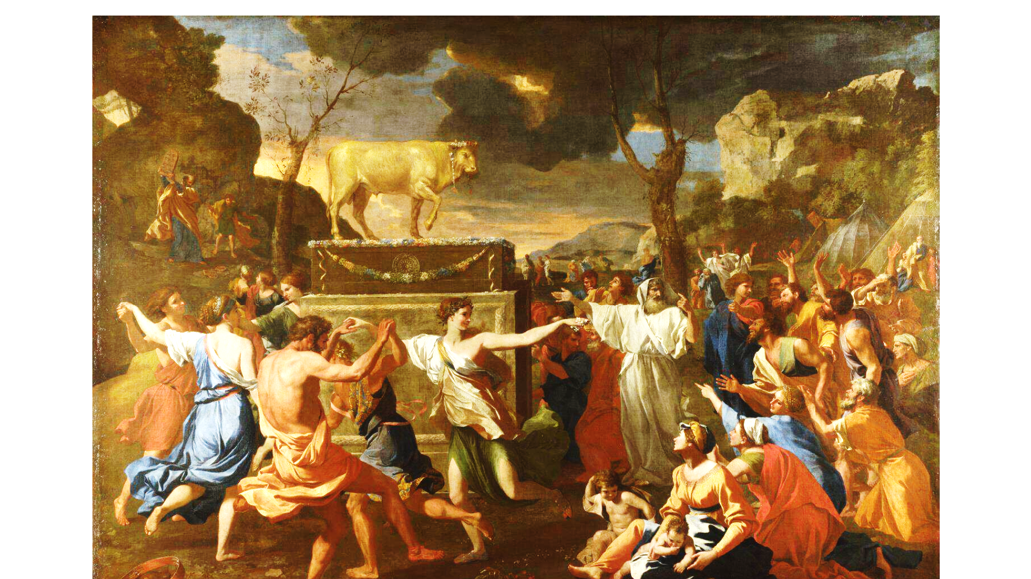

Slide 34
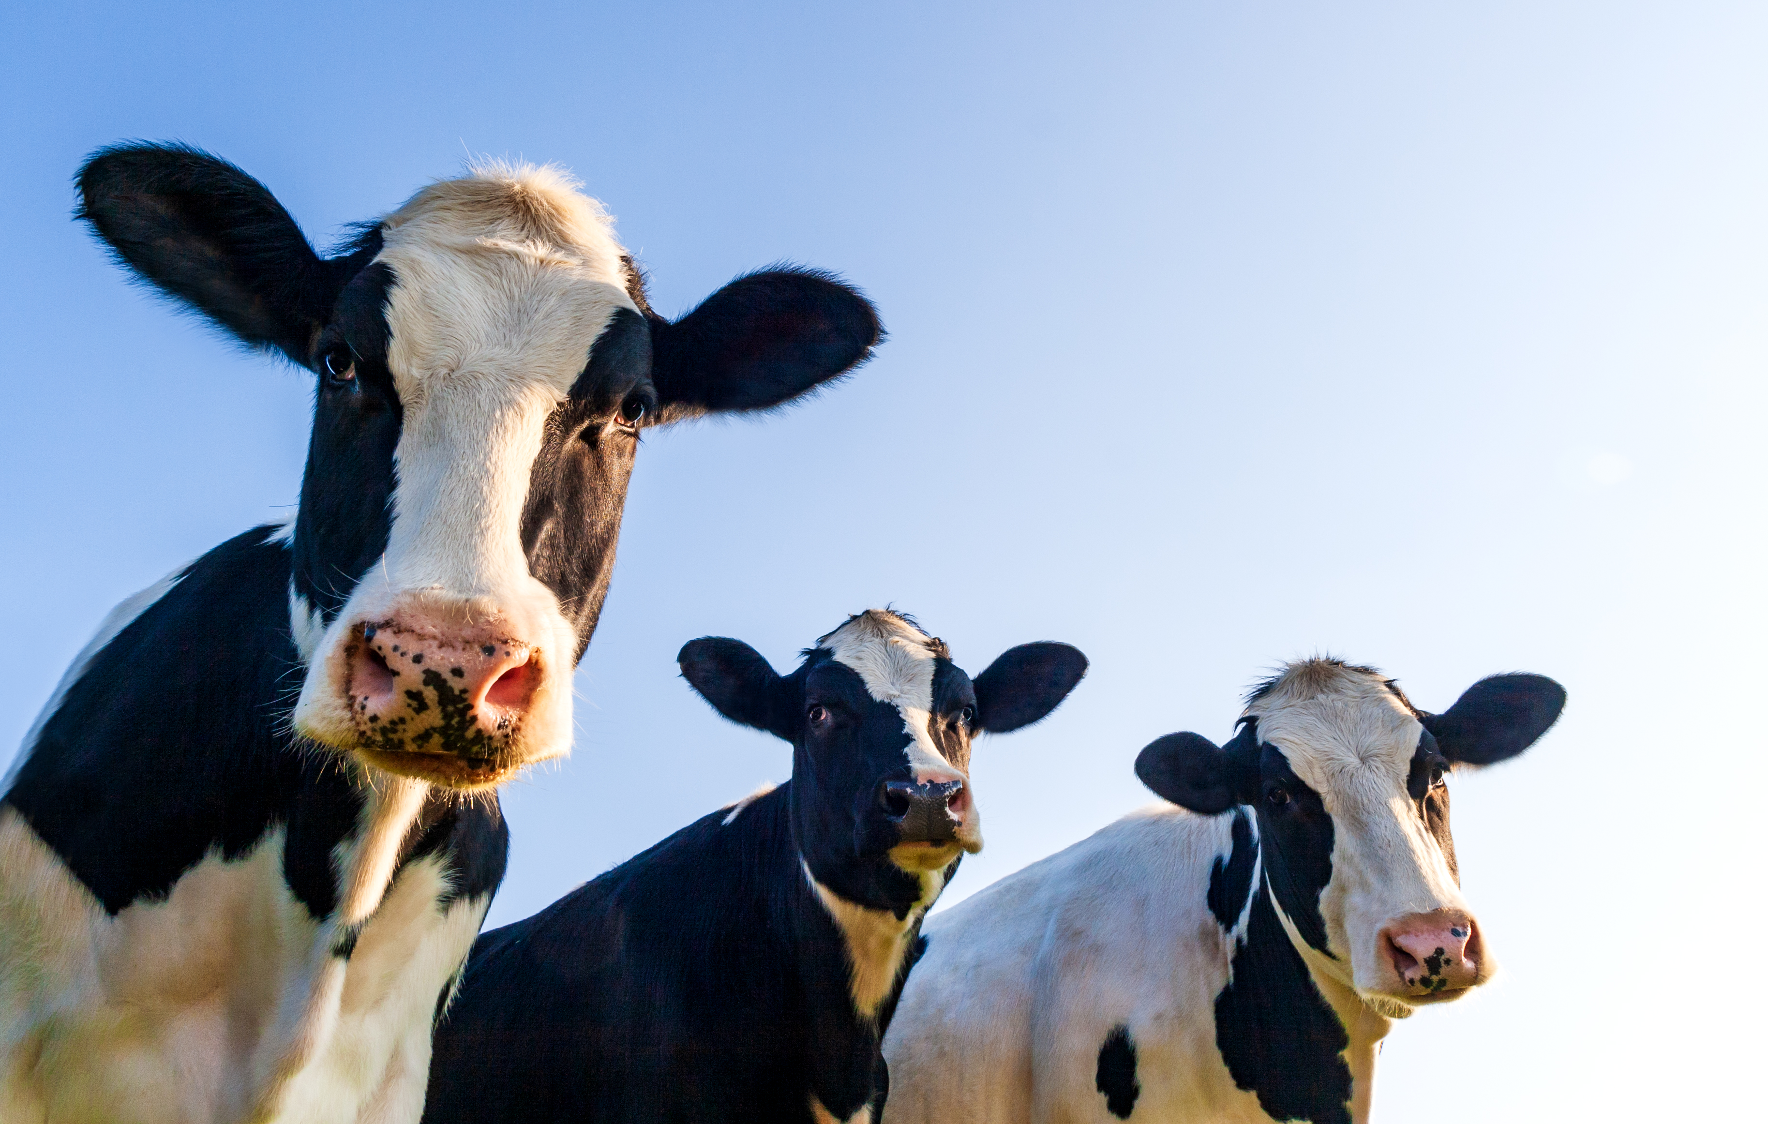
You become like what you worship A calf’s life:

Slide 36
Mediator: a go-between to restore peace between God and humans

Slide 37
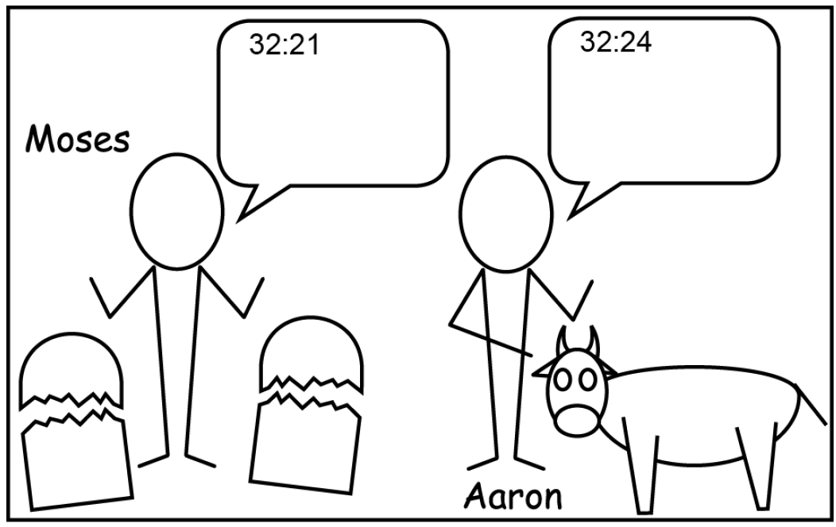

Slide 38
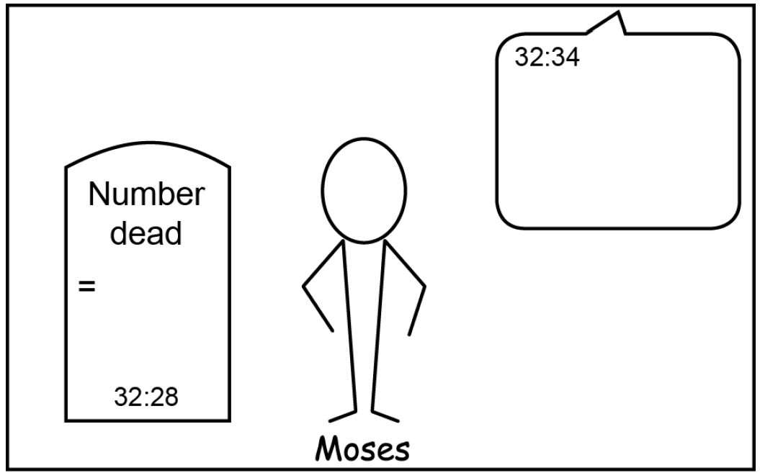

Slide 39
Why share Jesus?
Are your friends worshipping an imaginary “god”?
Approval, grades, comfort, love
Family idols, man-made religion
Will their sins be punished in due time?
Who is our mediator?

